Slide 1
Mystery, Tragedy, Fantasy, Adventure. . . Are You Telling Your Board the Right Fundraising Story?
Presented by
Amberlie Phillips
Managing Partner, Pathway Associates

Slide 2
Our Session Today
Explore common board fundraising stories
Identify elements that contribute to story formation
Assess and identify your own board fundraising story
Review tools to shift the narrative
Identify and prioritize action steps you will take to change/strengthen your fundraising communication with the board

Slide 3
My Inspiration: Ancient History
“In the end, it is impossible not to become what others believe you are.”
Gabriel García Márquez (quoting Julius Caesar)

Slide 4
Is your board’s story ancient history?
Past successes or failures regularly brought up
Something that happened long ago still colors the board’s approach to fundraising
Donors who haven’t given in years are still on the prospect list
Ideas and approaches that are familiar

Slide 5
Fantasy
“There is money, spend it, spend more.”
William Shakespeare, The Merry Wives of Windsor

Slide 6
Is your board’s story fantasy?
Revenue numbers are unrealistic
Revenue increases are not met with corresponding expense increases
Budget to actuals have little/no relation to the flow of the fundraising year
New initiatives are given outsize importance
Folks are considered prospects before they are qualified

Slide 7
Mystery
““In a world of diminishing mystery, the unknown persists.” Jhumpa Lahiri, The Lowland

Slide 8
Is your board’s story mystery?
The “contributed income” line is the extent of the fundraising report
The development dashboard consists only of revenue numbers and no other metrics
The development program is not regularly on the agenda
There is no board member who represents development as a volunteer (i.e., committee chair)

Slide 9
Other types of stories. . .
Horror: Don’t open the door and let the fundraiser in. . .
Thriller: How will it end?
Tragedy: Never ends well!
Western: Taming the Wild West
Myth: A hero’s journey
Other narratives?

Slide 10
Let’s Assess! “Poirot," I said. "I have been thinking." "An admirable exercise, my friend. Continue it.” Agatha Christie, Peril at End House

Slide 11
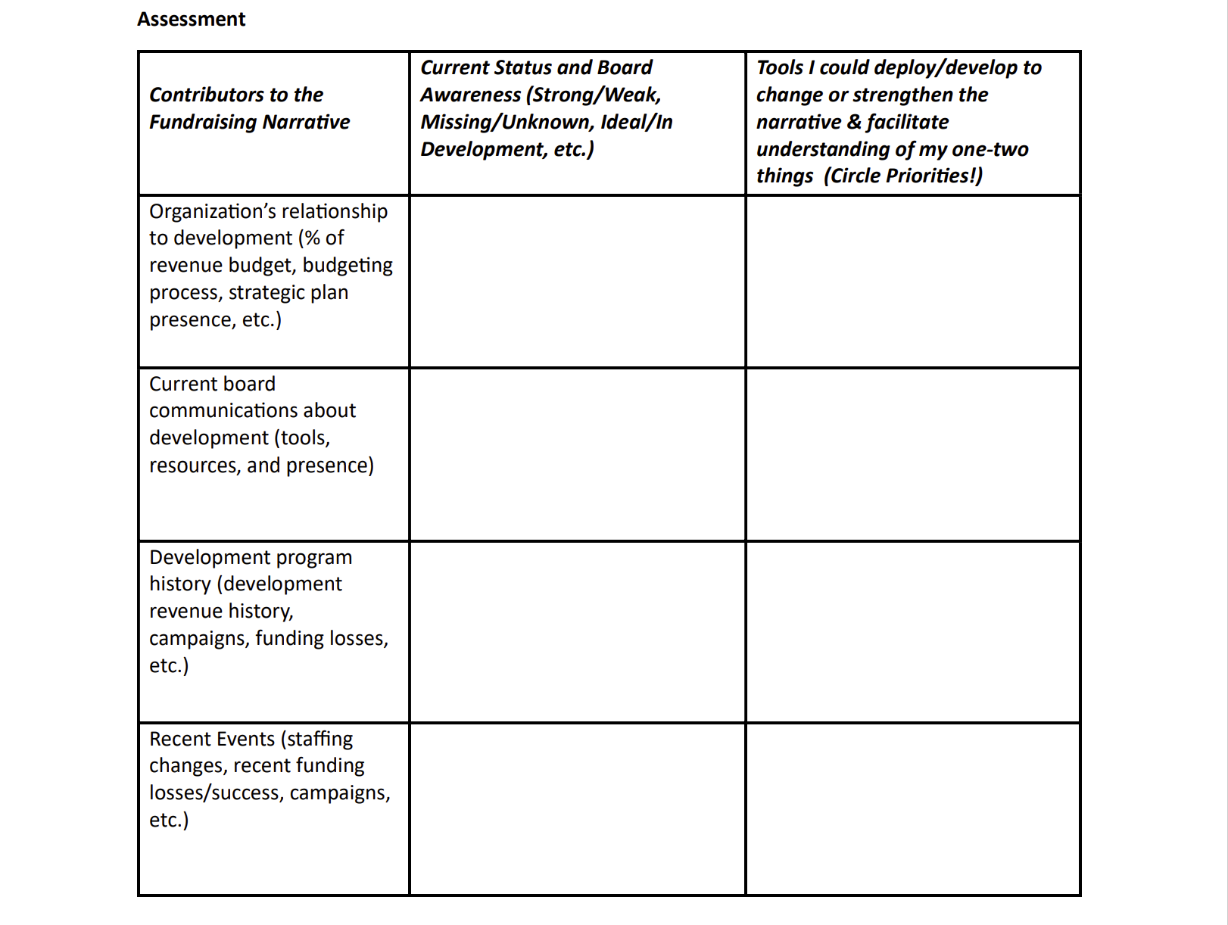

Slide 12
Assessing Your Current Narrative
Organization’s relationship to development function
Development communications at the board level
History of the development program
Recent events

Slide 13
Assess: Organizational Relationship
Relative importance of development to overall organization
Strategic Plan/Direction
Budgeting

Slide 14
Assess: Board communications
Board tools and resources
Onboarding
Board agreements
Board meetings/packets/agendas
Board processes
Budgeting
Strategic plan
Executive evaluation

Slide 15
Assess: History and Recent Events
Development Program over last three-five years
Revenue shifts
Staffing
Go back further if you can!
Recent events
Won or lost grants
Major gifts
Staff turnover

Slide 16
Please share! What is your Board’s Story?

Slide 17
Shifting your Narrative : Choose Your Own Adventure
“It isn’t what we say or think that defines us, but what we do.” Jane Austen, Sense and Sensibility

Slide 18
Review and Reflect: What is the one (or two, max) thing that the board must understand about your development program?

Slide 19
Tools to Shift the Narrative
Share the history
Share the process
Dashboard that is more than just numbers
Share the plan
Enlist allies
Give the board the choice in the adventure

Slide 20
The Board: Choosing Their Own Adventure
When it comes to fundraising:
Where have they shown up in the past?
Where have they not engaged?
What are their strengths, collectively and individually?
What would they say if you asked them these questions?

Slide 21
Control the narrative Narrative is one of the best intoxicants or tranquilizers.” A.S. Byatt, Still Life

Slide 22
Prioritization, Patience and Persistence
Don’t try to deploy all the tools at once!
Stick to those that support your one or two things
Be transparent
Demonstrate excitement
Meet them where they are
“Change requires intent and effort. It really is that simple.”
Roxane Gay, Bad Feminist

Slide 23
Thank You
Amberlie Phillips
Pathway Associates
amberlie@pathwayassoc.com
Find me on goodreads: https://bit.ly/amberliereads

